Slide 1

Capstone Project-1 Hotel Booking Analysis
Team Members
Y Bhanu Prakash
Harish K
Maria Kumar
D Sri Vardhan
Suresh Kumar Pulavarthi
maBetter
Al

Slide 2

HOTEL BOOKING ANALYSIS DETAILED OVERVIEW
Introduction
Problem Statement
Material
Understanding of the Dataset
Steps involved
Data Visualization
Conclusion
HO
tel Booking Analysis

Slide 3
Introduction
Hotel industry is very volatile, and the bookings depend on various factors such as type of hotels, seasonality, days of the week, and many more.
This makes analyzing the patterns available in the past data more important to help the hotels plan better.
We will use the available data to analyze the factors affecting hotel bookings. These factors can be used for reporting trends and predicting future bookings.
Using the results from the above analysis, a hotel business can make key decisions regarding the customer experience they desire to deliver.
HO
tel Booking Analysis

Slide 4
Problem Statement
To explore and analyze the data to discover key factors responsible for predicting Hotel Booking and increasing the Hotels revenue.
Our mission is to assist Hotel management by analyzing and visualizing available data to increase revenue.
For this reason, we are looking at customer types, hotel bookings, cancellations, customer needs, and various permutations and combinations.
HO
tel Booking Analysis

Slide 5
Material
Data Cleaning
Hotel Data Frame
Information
Data Visualization
Predicted Future Bookings and Increase the Hotel Revenue
HO
tel Booking Analysis

Slide 6
















Understanding of the Data Set
Is Cancelled
Customer Type
Lead Time
ADR (Average Daily Rate)
Date, Year & Month
Hotels
Week & Weekend Nights
Reservation Status
Country
Is repeated Guest or not
Market Segment
Previous Cancellation
Booking Changes
Distribution Channel
Deposit Types
Meal Preference
tel Booking Analysis
HO

Slide 7




Steps Involved
Implementing The Dataset: First, we have to import the necessary libraries as;
Then we loaded the CSV file from Google Drive.
The given dataset is to be imported and defined as Hotel Booking Analysis.
pandas
numpy
DATA
matplotlib
seaborn
HO
tel Booking Analysis

Slide 8
Steps Involved
Cleaning the Data:
Final
Review
Data Manipulation
Manage Outliers
Remove Duplicate Values
Remove Unwanted Columns
Dealing Null Values
HO
tel Booking Analysis

Slide 9
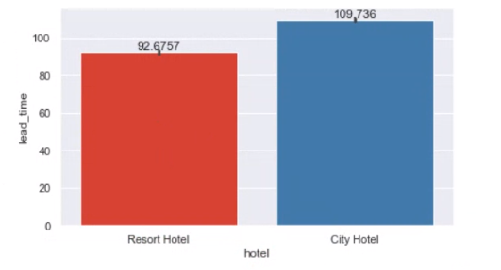
Data Visualization
Lead Time of Hotels:
The number of days between the time a guest books their room and the time they are scheduled to arrive at the hotel.
HO
tel Booking Analysis

Slide 10
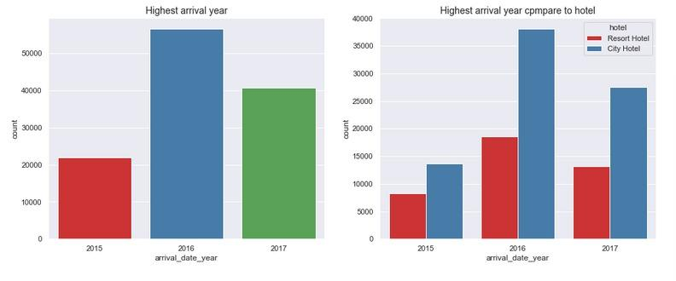
Year with the highest arrivals:
Below is an illustration of customers’ arrival for years between 2015 to 2017.
Below is an illustration of customers’ arrival for the years 2015 to 2017 between Resort and City Hotels
HO
tel Booking Analysis

Slide 11
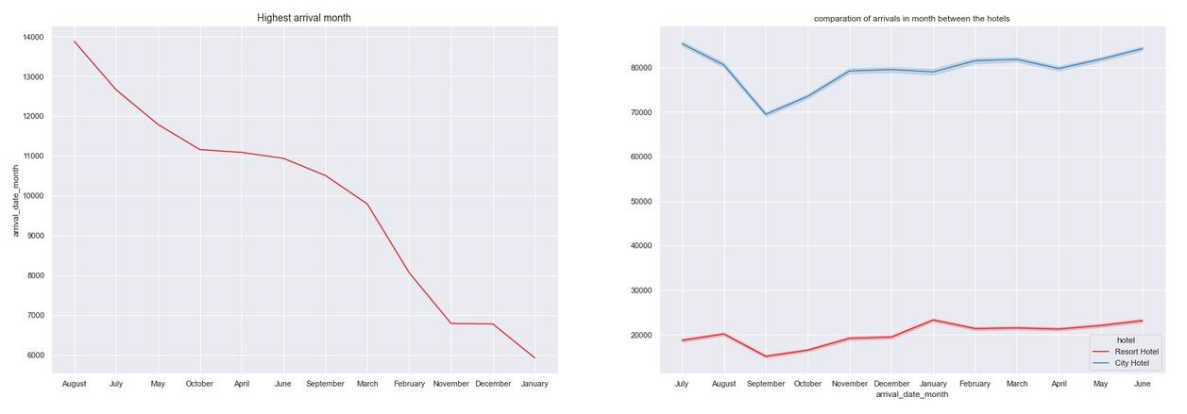
The month with the Highest Arrivals:
The below graph shows the customer arrival data for various months. We can see in August customers are
showing interest to stay in the hotels as part of their tourism, also illustrated for both hotels separately.
HO
tel Booking Analysis

Slide 12
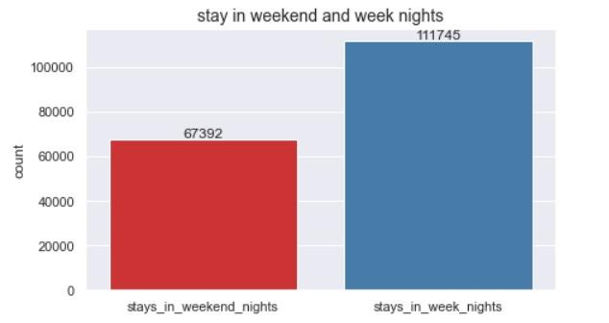
Comparison of stay for Week and Weekend Nights:
People prefer night stays during Weeks
than weekend nights, which is a profitable
to hotel management.
HO
tel Booking Analysis

Slide 13
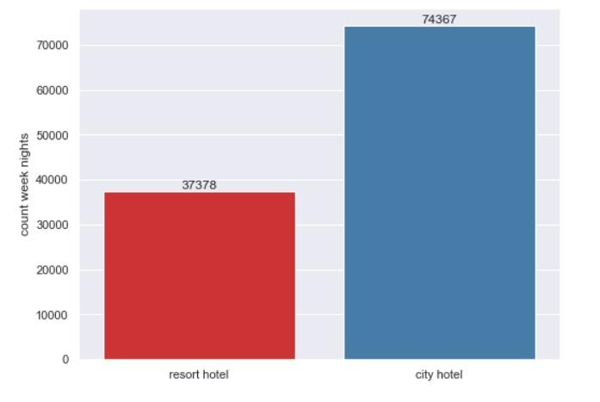
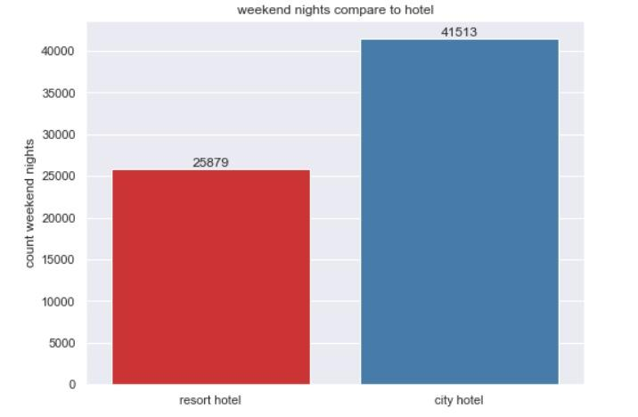
Preferred Night stay at City and Resort Hotels:
Hotel preference of most people to
stay on Week Nights of
all years of the given data.
People prefer to choose
City Hotel over Resort Hotel.
Hotel preference of most people to
stay on Weekend Nights of
all years of the given data.
People prefer to choose
City Hotel over Resort Hotel.
HO
tel Booking Analysis

Slide 14
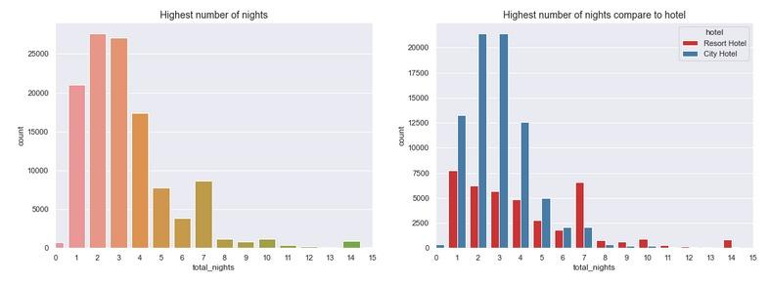
Preferred no. of days for Night stay:
People wish for a night stay in a hotel (preferred City Hotel) for 2 to 3 days rather than a week or more during their travel which is a profitable thing for the hotel as the customer is having fewer options to bargain with hotel staff regarding the price.
HO
tel Booking Analysis

Slide 15
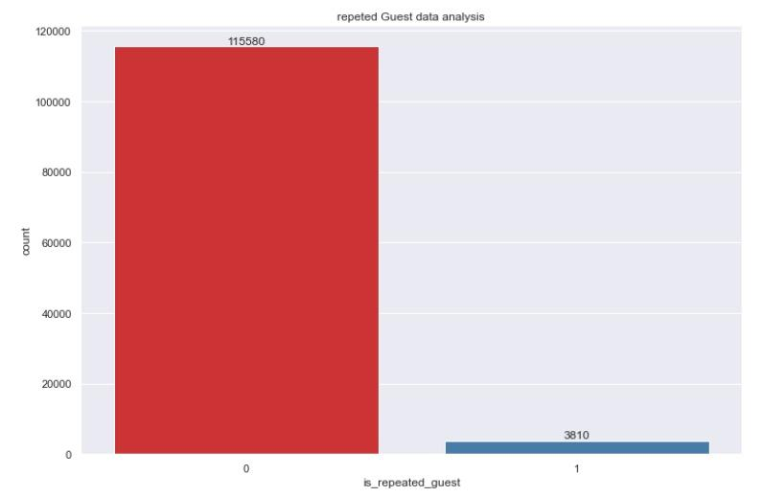
Repeated Guests Data:
The below graph explains the repeated customers over time to both the city and resort hotels respectively.
HO
tel Booking Analysis

Slide 16
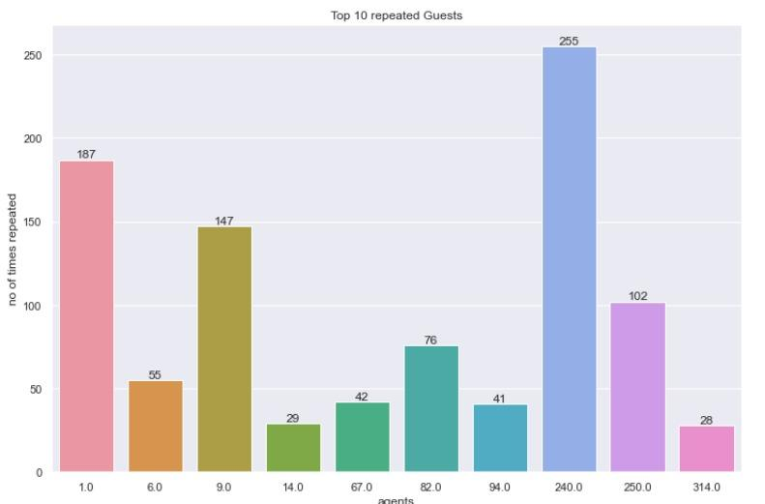
Top 10 agents chosen by Repeated customers:
Could see that repeated customers are choosing the prior agents to book their stay and agent 240.0 is making the big number and helping the customers to pick the hotel.
HO
tel Booking Analysis

Slide 17
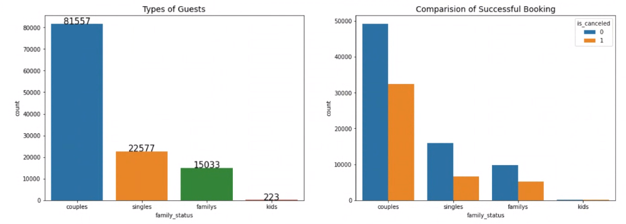
Customers Visiting Data Analysis:
The below explains the types of customers when grouped with a couple of variables.
HO
tel Booking Analysis

Slide 18
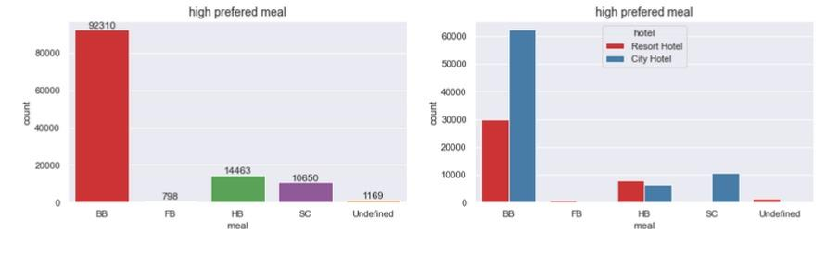
Meal Analysis:
Below 2 explains the meals preference of the different types of customers and also for the City and Resort Hotels as well. Also, customers prefer to have BB (Bread and Breakfast) meals in both hotels.
HO
tel Booking Analysis

Slide 19
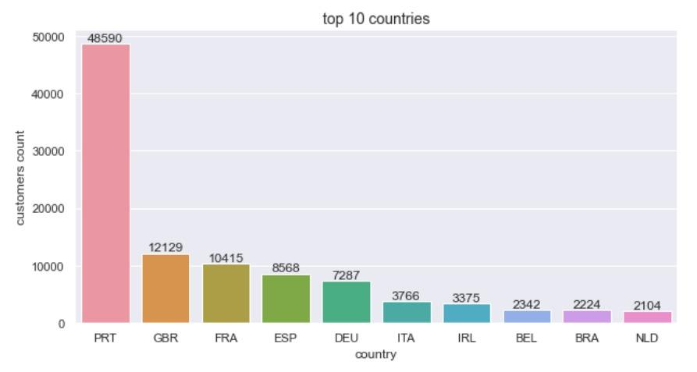
Customers from the Top 10 countries:
Most of the customers visited from PRT(Portugal) country than the other countries.
HO
tel Booking Analysis

Slide 20
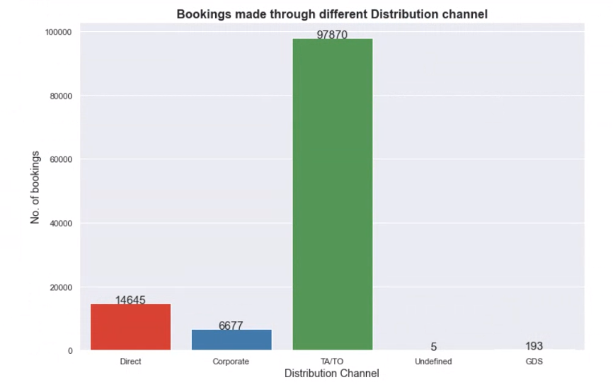
Distribution Channel:
The below picture evidence majority of the hotel bookings are done by Online and/or Offline travel agencies.
HO
tel Booking Analysis

Slide 21
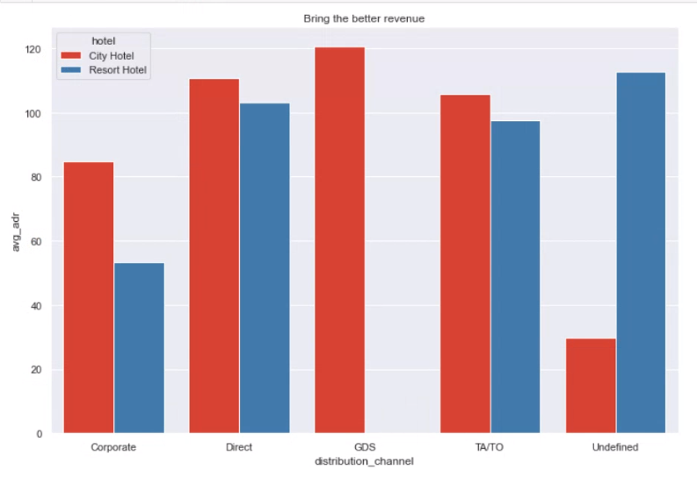
Average Revenue Generated by Distribution Channels:
It is a piece of clear evidence that the hotel’s revenue is coming mostly from distribution channels only.
HO
tel Booking Analysis

Slide 22
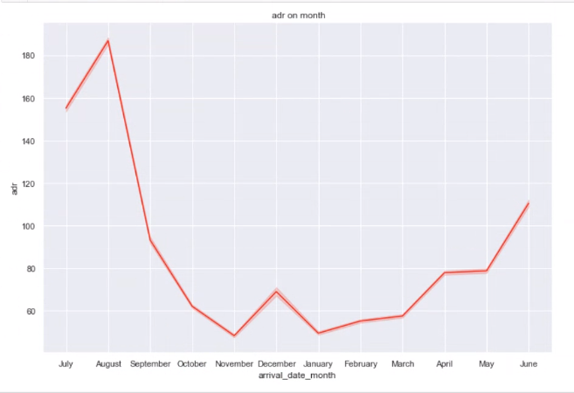
Month-wise Average revenue generated:
Below is the price variation between ADR(Average Daily Rate) and customer arrival month.
From July to August, we can see a price increment and after that, there is a drastic decrease
in price and a very small increase in price. Hence we can see customers prefer to plan their
vacation during the July to August season only.
HO
tel Booking Analysis

Slide 23
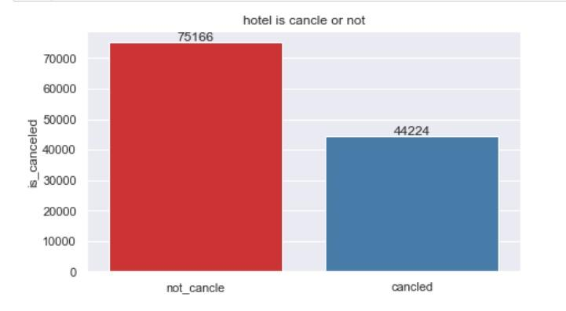
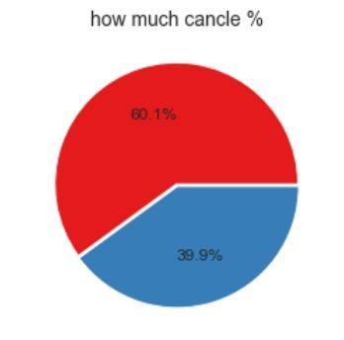
Comparison of Cancellation and Successful bookings:
The below figure(s) shows the cancellation and successful booking status and percentage of the overall data of the customers and hotels.
HO
tel Booking Analysis

Slide 24
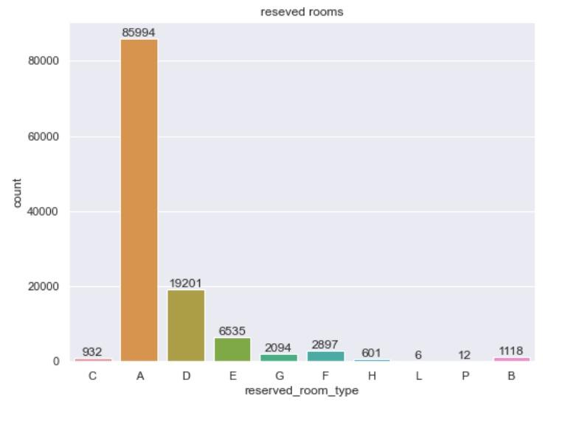
Reserved Room Type Analysis:
Here we are analyzing the data of the bookings of room types. How many room types are there and customers’ preferences for the various room types? Based on these hotels can concentrate on which room most customers preferred and make a profit with the analysis.
HO
tel Booking Analysis

Slide 25
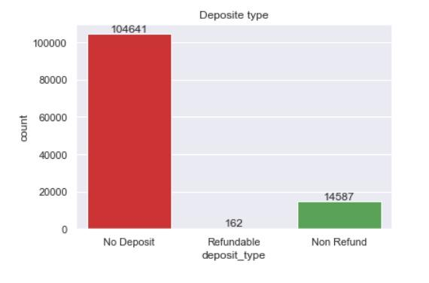
Deposit type analysis:
The below analysis explains how customers prefer the hotel stay, most of the customers are
taking accommodation without making any deposit and post completion of the stay or during
the checkout customers’ making the payment.
HO
tel Booking Analysis

Slide 26
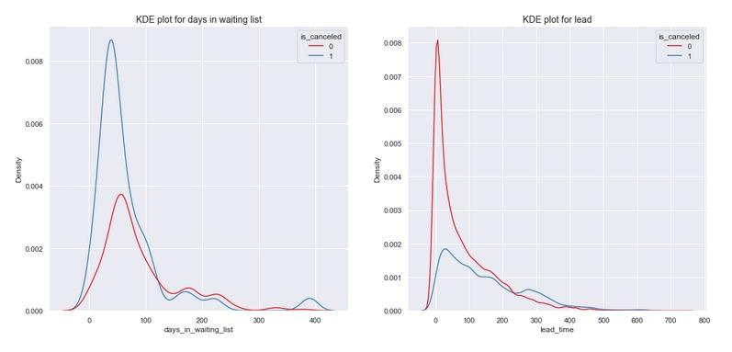
Most bookings canceled have a waiting period:
We see that most of the bookings that are canceled, have a waiting period of fewer than 150 days but also most of the bookings that are not canceled also have a waiting period of fewer than 150 days. Hence this shows that the waiting period does not affect the cancellation.
HO
tel Booking Analysis

Slide 27
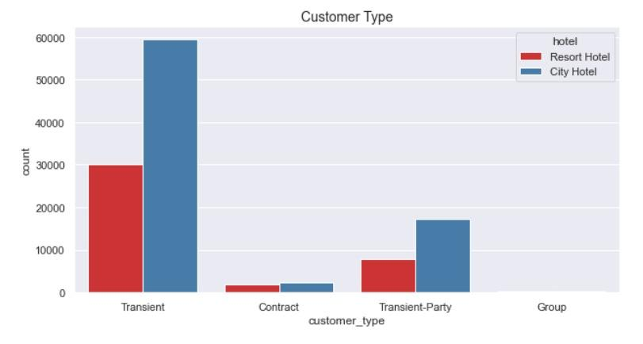
Customer Type:
This picture is the analysis of the different customer types of City and Resort Hotels.
HO
tel Booking Analysis

Slide 28
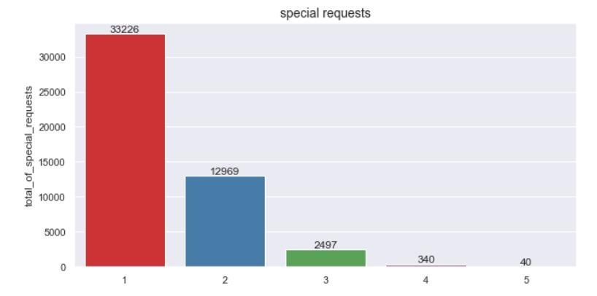
Special Requests Breakdown:
Looking at the below data could see most of the requests are single and
two requests are less than 50% of single requests. Hence hotels should concentrate on this type of data and serve the customers accordingly.
HO
tel Booking Analysis

Slide 29
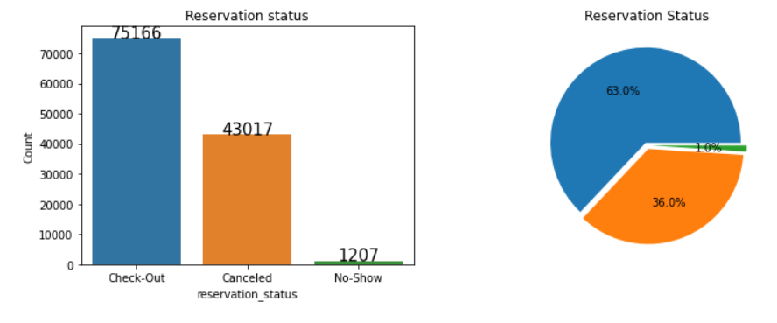
Booking Cancelled due to No-Show:
From the below graph, it is clear evidence that the customers are checking out after their stay but also customers are not showing up though their stay status is successful. Hotels should concentrate on this issue and try to find a way to minimize these.
HO
tel Booking Analysis

Slide 30
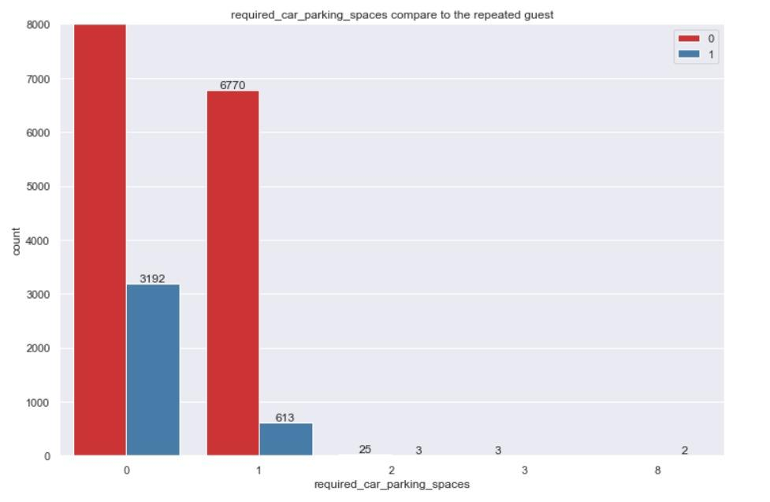
Car Parking Space requests Exploration:
Could see car parking space requests are more from new customers and very few from repeat customers. Hence hotels should be more attentive to this analysis and act accordingly.
HO
tel Booking Analysis

Slide 31
Conclusion
From the Hotel Booking Data Analysis, we can see the following points are to be taken care by the hotels to improve their efficiency and revenue.
Most customers preferred ‘A’ room type and hotels should concentrate on increasing these rooms.
Cancellation requests are very high and more than 50% of the reserved rooms are canceled due to no deposit taken from customers. So hotels should start imposing charges on cancellations and encouraging customers to not cancel their stay.
From the customer types, we can see Transient category customers are more hence hotels should attract this category’s customers by introducing offers and encouraging the customers to not cancel their stay.
Could see during July and August months the bookings are sky high so hotels should introduce some offers and discounts during this period to attract more customers and gain more profits.
As the repeated customer numbers are too low hotels should start concentrating on this kind of customer and try to acquire them by introducing some discounts to this kind not losing the new numbers. This will encourage the new numbers as well.
As the customer numbers are from the UK, Portugal, and France hotels should concentrate on the people’s lifestyle of this western region and start improving their services and giving offers and deals to make them comfortable during their stay.
HO
tel Booking Analysis

Slide 32

maBetter
tel Booking Analysis
Al
HO

